Slide 1
IMF Europe International Investment Position by Group 5
€
€
€
Germany, Switzerland, Spain, Luxembourg, Austria
€

Slide 2
Table of contents
Introduction
Tools Used
01
02
Key Insights
03
Project Overview
04
€
Analyzing European IMF data for insights.
Tools used for the Analysis.
€
€
€
The insight gathered from the data
Overview of the project
€
Recommendations
Contributors
05
04
The recommendations
Those that made this project a success

Slide 3
“Investing should be more like watching paint dry or watching grass grow.”

Slide 4
01
Introduction
Analyzing European IMF data for insights.

Slide 5
Introduction
This project aims to analyze IMF data from five European countries (Austria, Germany, Luxembourg, Spain, Switzerland) for the period 2005 to 2023, focusing on trends in assets, liabilities, and net international investment position (NIIP). The data was transformed, analyzed, and visualized to uncover actionable insights and provide recommendations.

Slide 6
Strategy and Plan
1
2
3
Extraction of Data
PreProcessing
Schema Design
5
4
Data Analysis
Visualization

Slide 7
Entity Relationship Diagram (ERD)

Slide 8
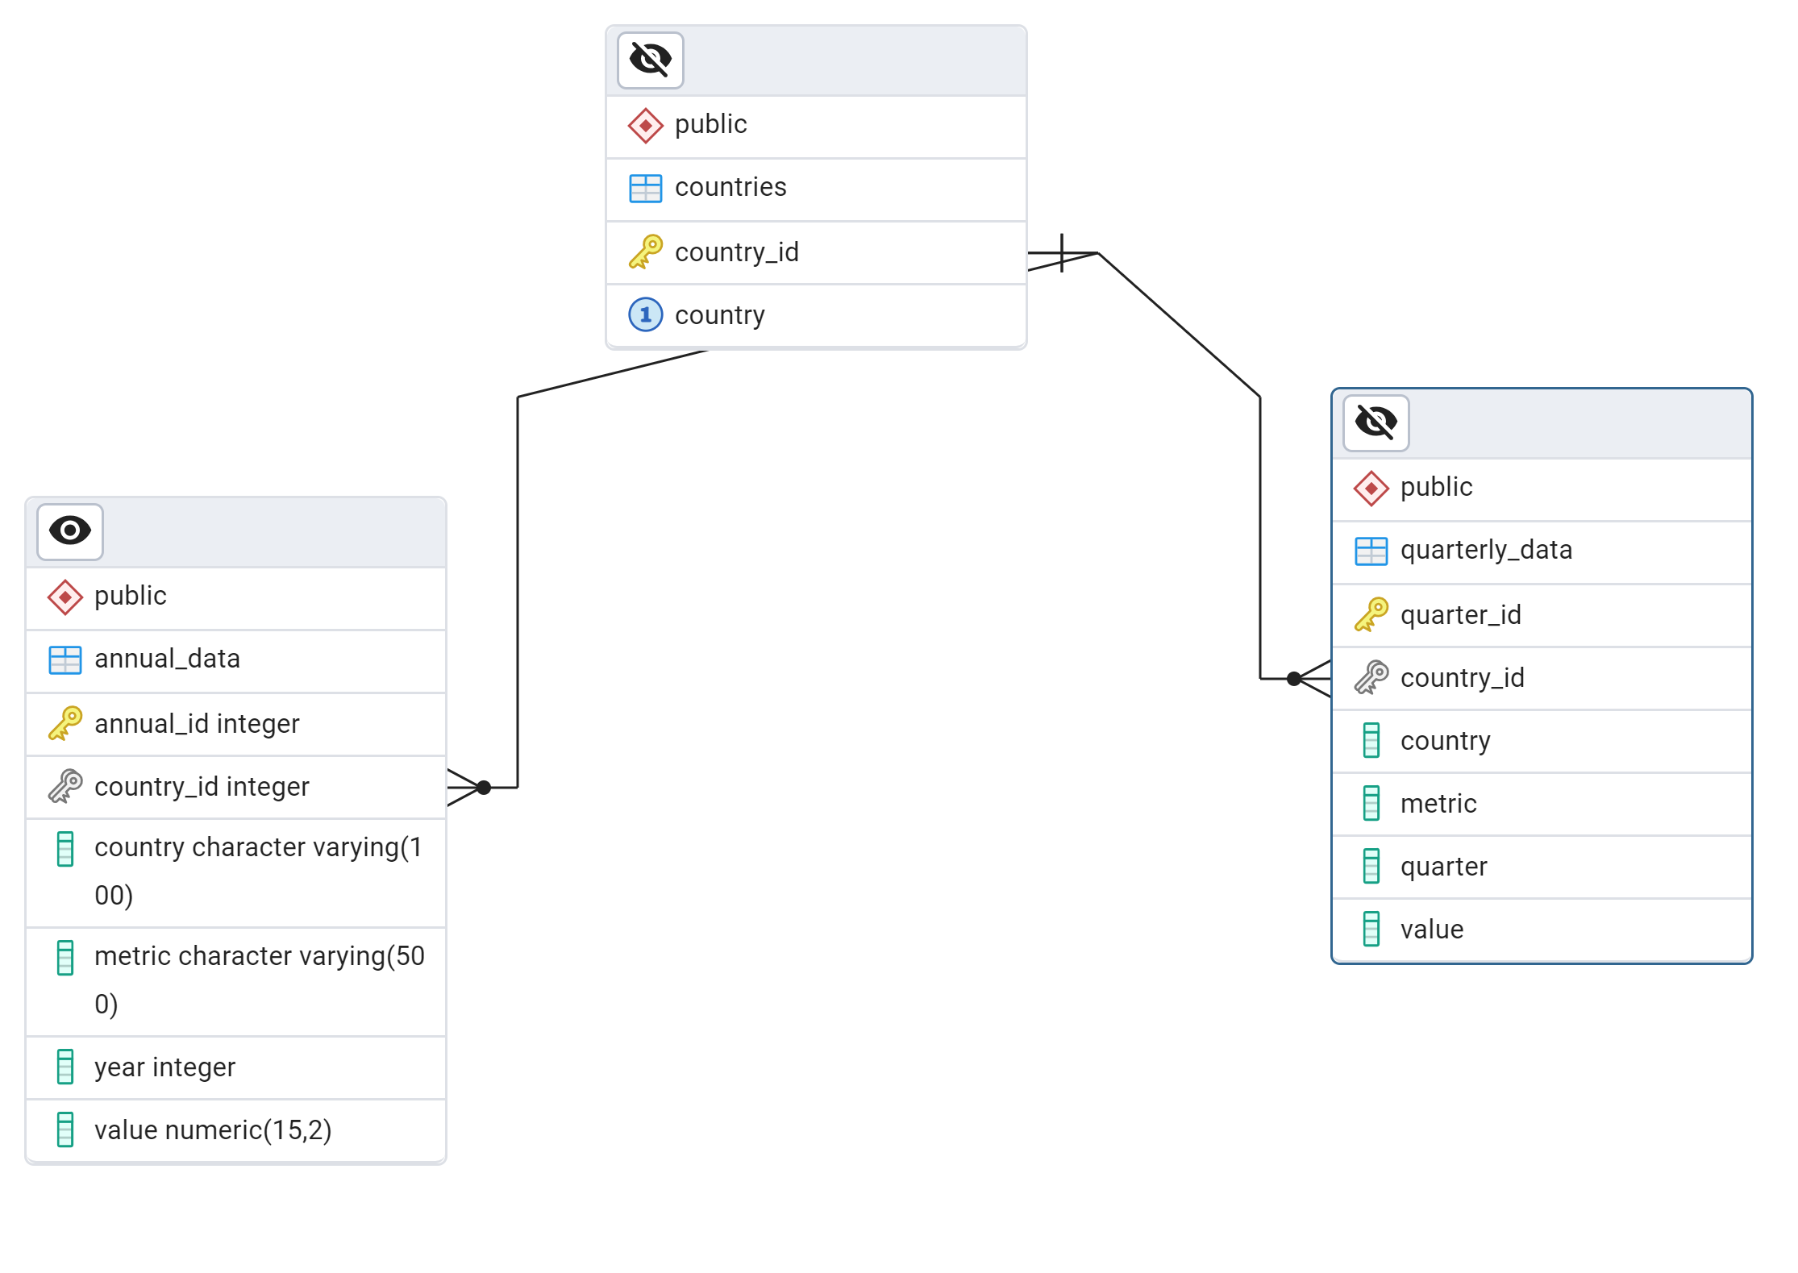
Entity Relationship Diagram (ERD)

Slide 9
02
Tools Used
Tools used for the Analysis.

Slide 10
Tools
Data Source
Data Cleaning
Visualizations
Data Analysis
IMF Database
SQL & Excel
Power BI Dashboards
Power BI

Slide 11

03
Project Overview
€
Overview of the project
€

Slide 12
Objective:
To extract, clean, analyze, and visualize economic data, identifying trends and insights in assets, liabilities, and investments across the five countries.

Slide 13
Deliverables:
1
Cleaned database and SQL scripts.
3
Power BI dashboards for analysis and visualization.
2
ERD diagram for relational data.
4
Documentation of findings and recommendations.

Slide 14
04
Key Insights
The Insights gotten from the analysis

Slide 15





Countries
Switzerland
1
Germany
1
Spain
1
Luxembourg
1
Austria

Slide 16
€4.14B
€491M
€741k
€68M
Overall Metrics (2005 – 2023)
Total Assets
Total Liabilities
Avg Net International Position
Equity and Investment

Slide 17
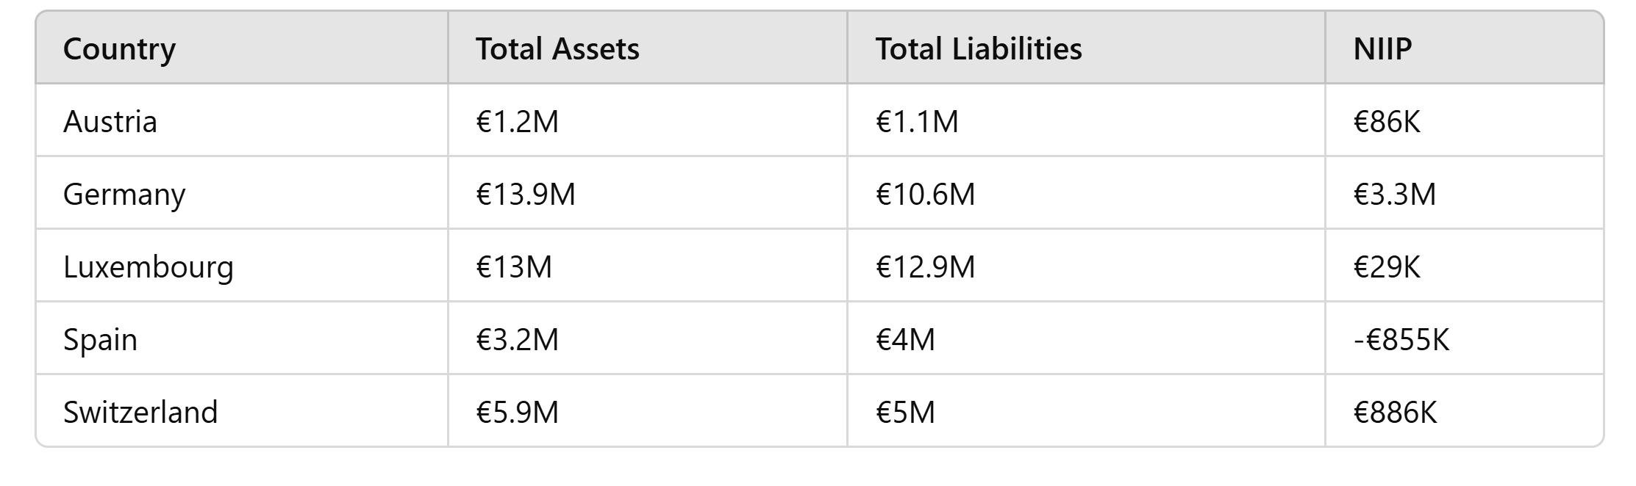
Annual Data Insight

Slide 18
Top Contributors by Assets
1
Germany
1
Luxembourg
Switzerland
€13.9M
€13M
€5.9M

Slide 19
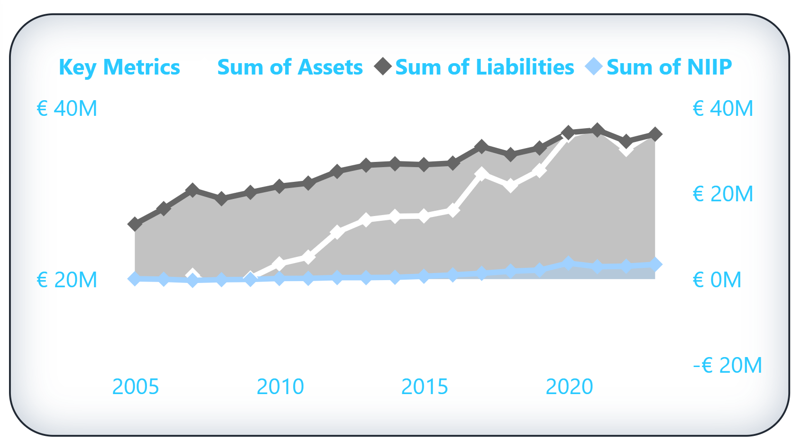
Key Metrics (2023)
Assets, Liabilities & Net International Investment Position (NIIP)
Assets:
Increased to €27M.
Liabilities:
Increased to €34M.
NIIP:
Steadily rose to €3M.

Slide 20
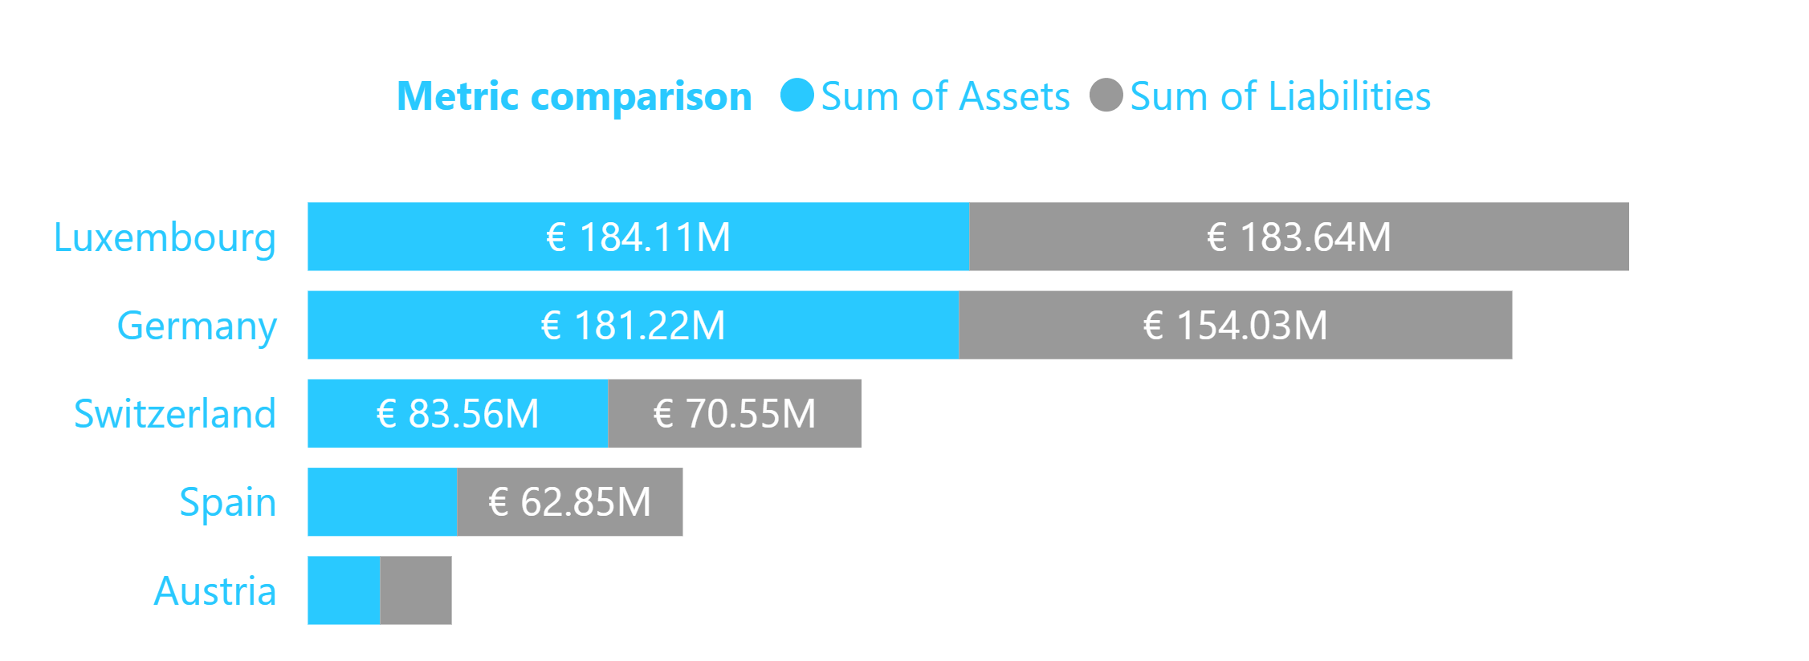
Metric Comparison by Country (2023)
Luxembourg:
€184M (Assets),
€184M (Liabilities)
Germany:
€181M (Assets),
€154M (Liabilities)
Switzerland:
€83.5M (Assets),
€70.5M (Liabilities)

Slide 21
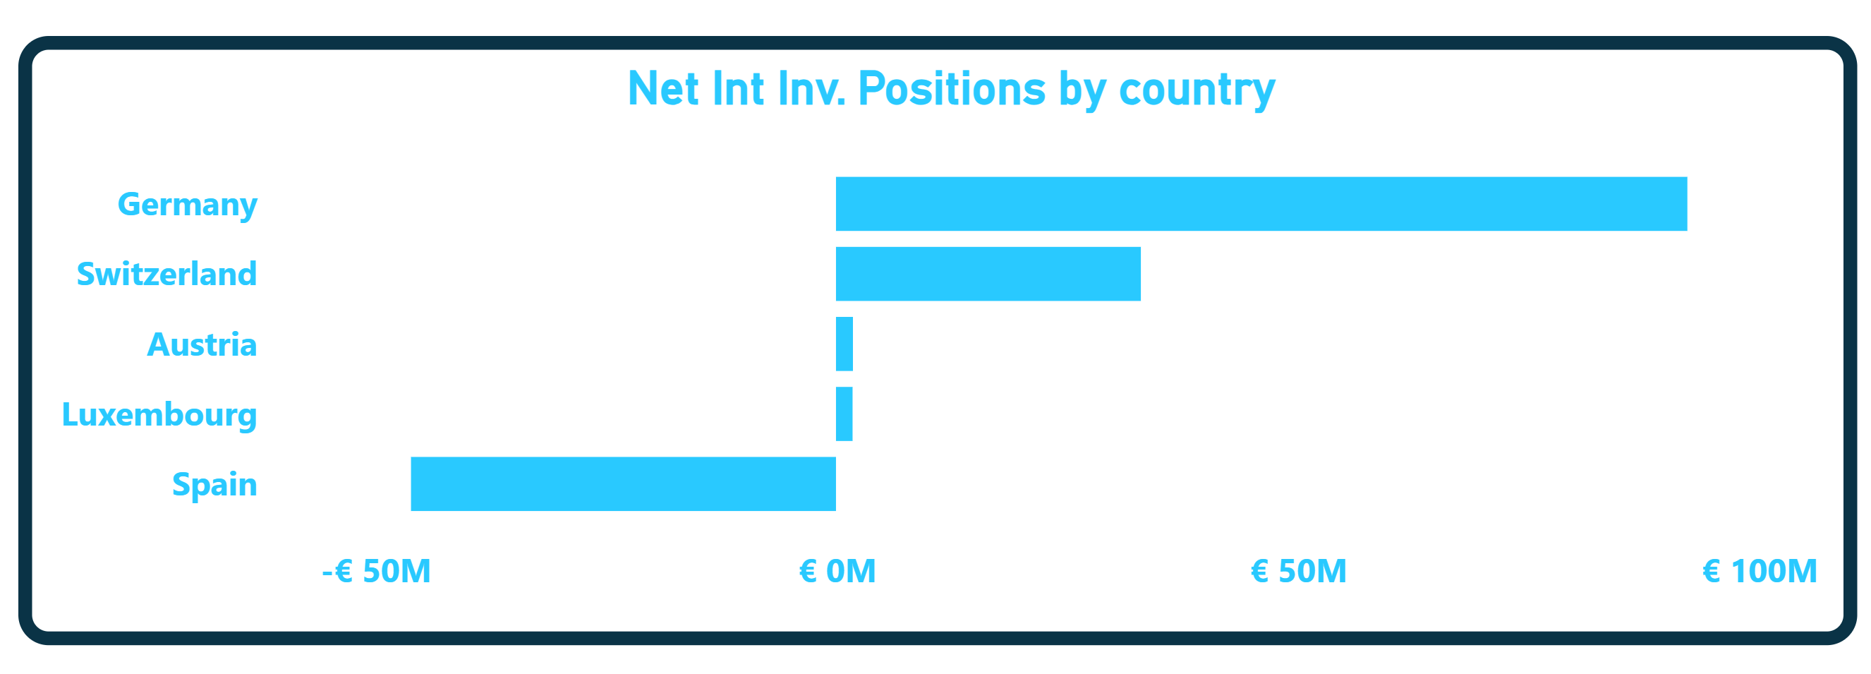
Quarterly Net International Inv. Position (NIIP)
Spain:
Spain is trailing behind at
-€50M
Though Austria and Luxembourg are not close to what Germany and Switzerland values in NIIP

Slide 22
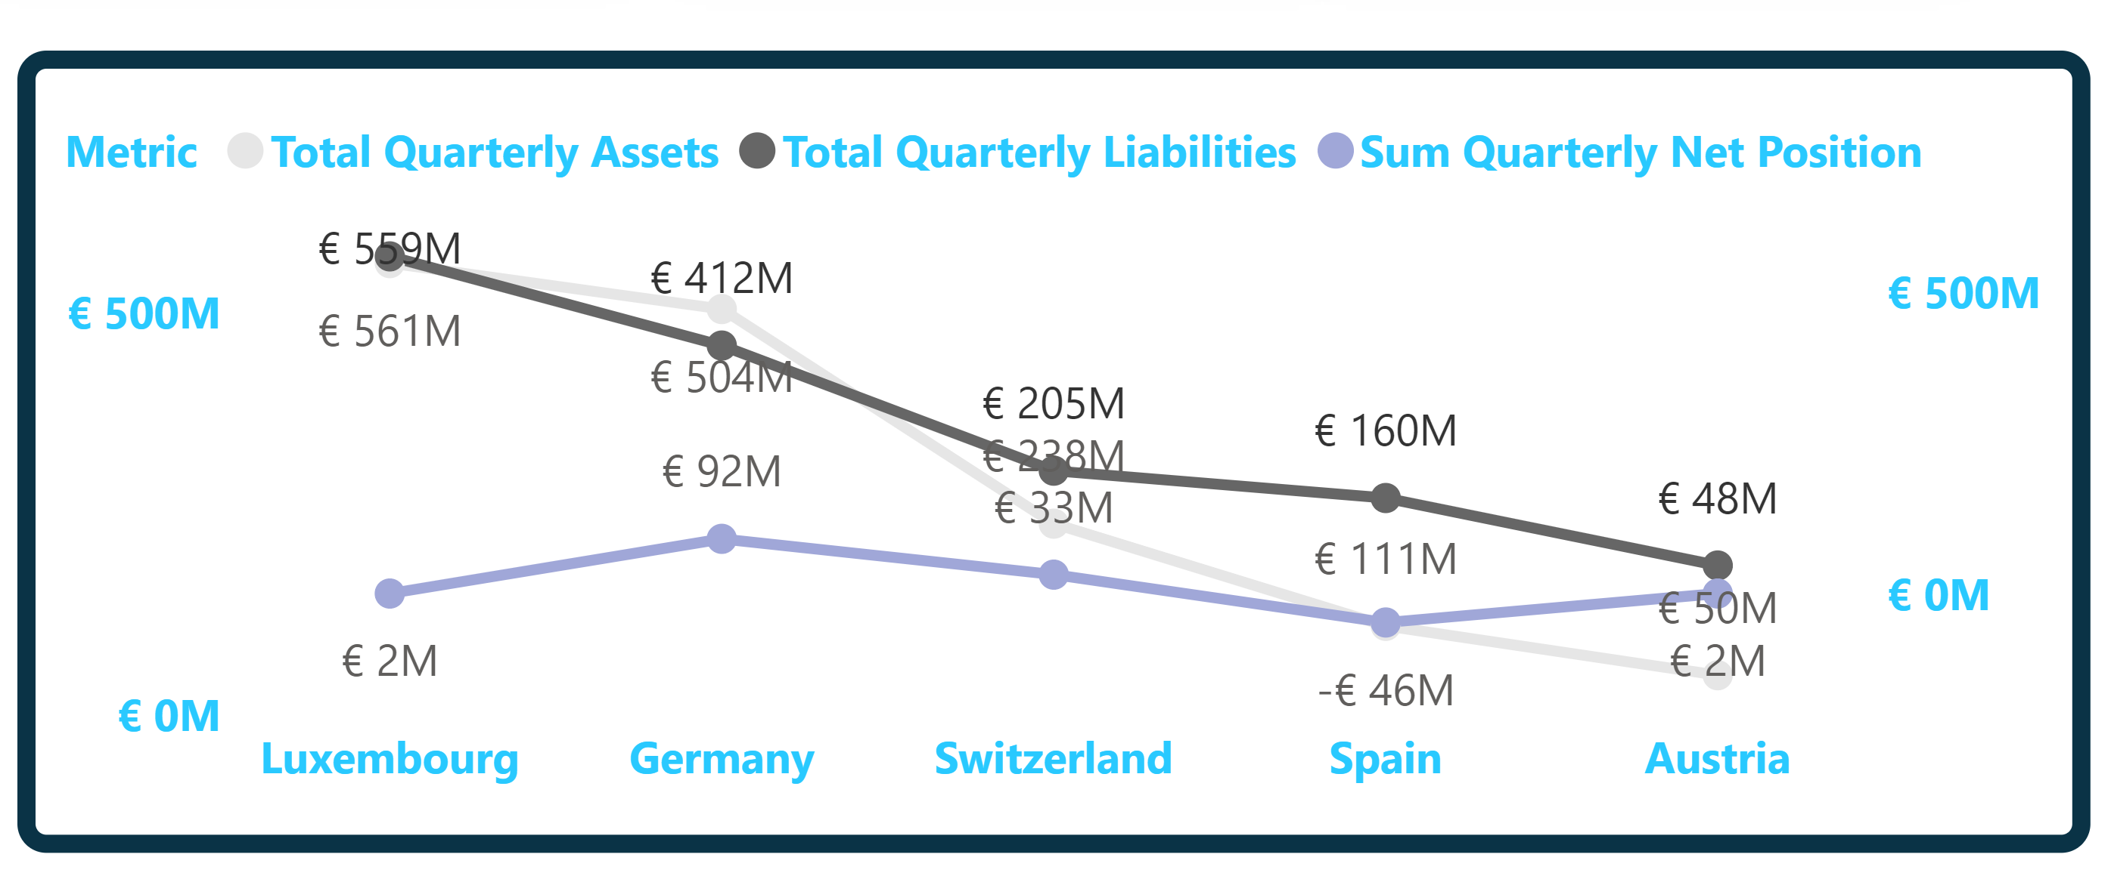
Quarterly Level Trend
Luxembourg ranks highest quarterly at €559M, €561M and €2M in Assets, Liabilities and NIIP

Slide 23
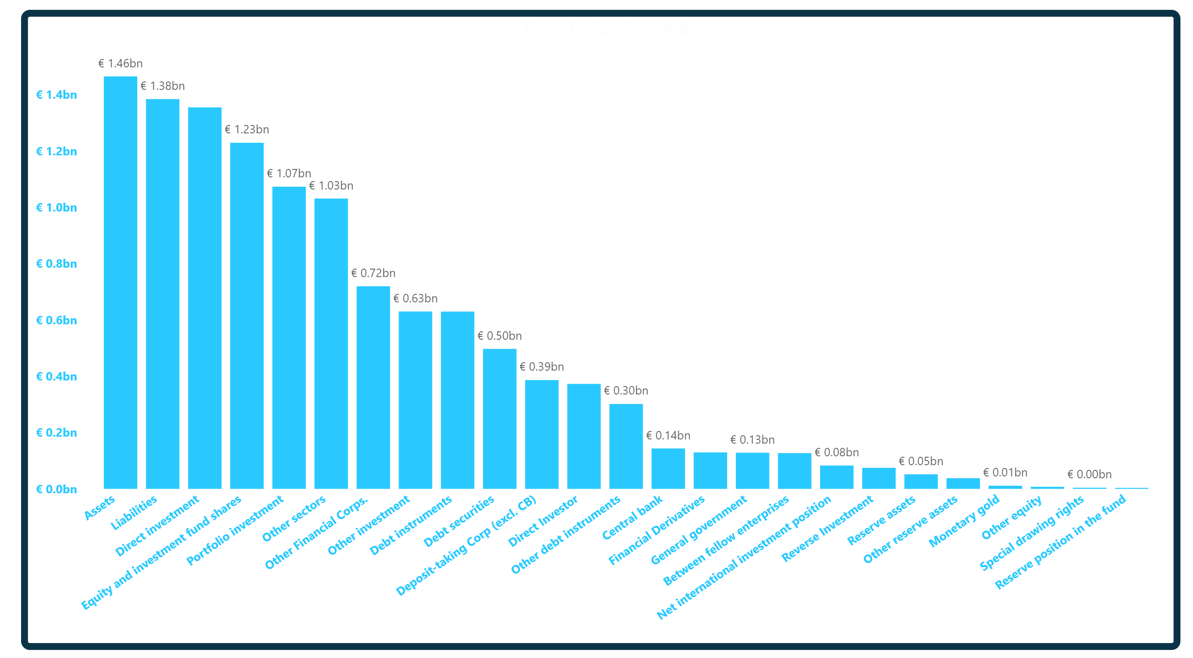
All Metrics
Top being Assets, Liabilities, Direct Investment and Equity & Investment Fund Shares

Slide 24
05
Recommendation
The Recommendation

Slide 25
Recommendations
Improve NIIP: Spain should focus on increasing assets or reducing liabilities to address its negative NIIP.
Enhance Financial Stability: All countries should aim to reduce liabilities to achieve a better asset-liability balance.
Capitalize on Trends: Utilize quarterly and annual data trends to make informed investment decisions.
Focus on Top Performers: Germany and Luxembourg’s economic models can be benchmarks for other countries.

Slide 26
6. Our team
Ifeka Odira H.
Covenant Lenu
Data Analyst
Data Analyst
Samual Israel
Adebayo Deborah
Data Analyst/PR
Data Analyst
Ajayi Adeboye
Okolie Kenechukwu
Backend Developer
Backend Developer

Slide 27
Resources
InternPulse
IMF Database
Draw.io
ChatGPT

